Slide 1
System Beginning of the Year Kick-Off
August 23 & 25, 2022
Notes:
Pre-meeting - music playing
To start, use Start me up - not sharing screen yet
Share FAQ with the group

Slide 4
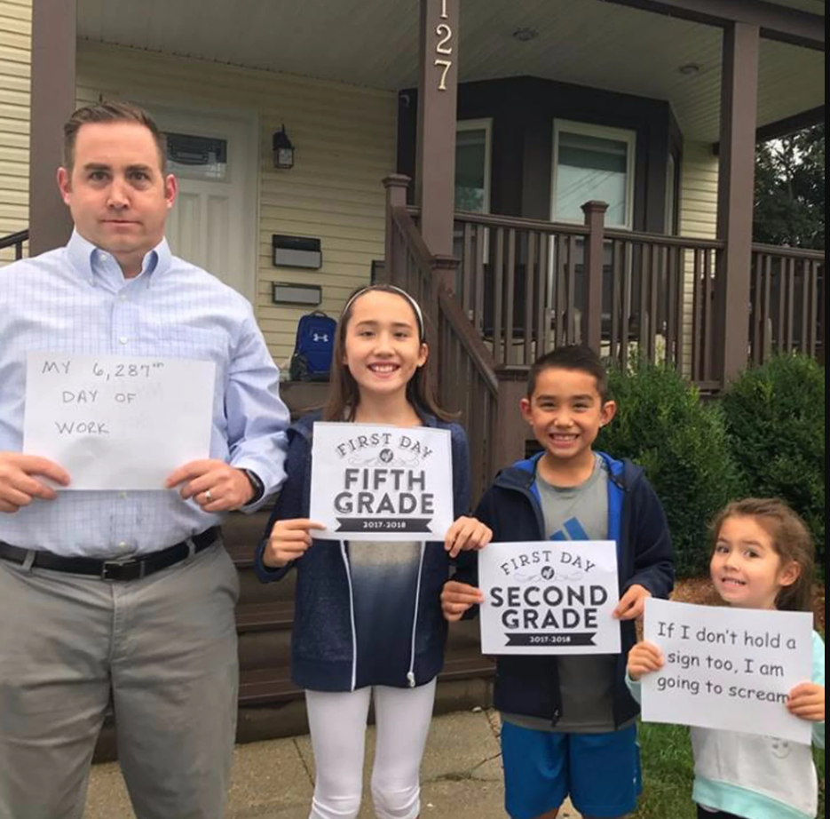
Notes:
Pre-meeting - music playing while BTS pics scroll with a logging into menti slide as well

Slide 5
Notes:
Be on camera as much as possible.
Make sure your mic is off when you are not speaking.
Add questions to the chat as needed for clarification.
Engage throughout the session via polls, chat, and breakout room discussions.

Slide 6
Objectives
Re-focus on the State Vision for Education and Board Outcomes
Understand the definition of accreditation in Kansas
Identify your next steps in KESA for the 2022-2023 school year
Clarity around ‘what’s next’ for Accreditation and Design
Notes:
Build excitement for the upcoming year
Who? Supts., Curriculum Leaders, Principles, KESA Directors
Inspire action toward the Kansans Can Vision; changing how we educate kids and how we hold ourselves accountable for the work
What is your vision for students in your schools? It needs to be shared, living, and a driver for action. Revisit it every year.
Provide context around SBOE outcomes
Leaving knowing ‘what’ they need to do (technical/process) this year
More than a compliance exercise
Change mindset from KESA = compliance → KESA = continuous school improvement
Process for capturing the work you are doing. Giving us insight into your work.
BR- Years 1-4: Needs Assessment & Goal Writing (and monitoring)
Connection to state legislated assessment
Direct them to our webpage; outline the CBA
Reporting changes for this year
BR- Year 5: Timeline, Tips for Reporting, ARC Criteria
What can folks expect moving forward?
2023/2024; focus group summary (Process & Product)
Clarity, Consistency, Redundancy

Slide 7
Agenda
Welcome & Initial Polls
Vision & State Board Outcomes
KESA & What it means to be accredited
Summary of Focus Group Feedback
Breakouts w/ Q&A
CBA - Component Baseline Analysis
Closing & Next Steps
Post-Meeting Q&A
Notes:
Welcome & Initial Polls (15 Mins-Jay)
AD Team & Mission
Vision & State Board Outcomes (15 Mins-Jay)
Process & Results
Menti Poll
KESA & What it means to be accredited (15 Mins-Sarah)
Menti Poll
Summary of Focus Group Feedback (15 Mins-Myron)
Menti Poll
Bridge Year → Future State
Breakouts w/ Q&A (35 Mins-Jay/Myron/Sarah)
Year 1 - Needs Assessment & Goals
Years 2-4 - Continuous School Improvement; working with your OVT
Year 5 - Walk through Summer Check In template & timeline for the year; working with your OVT
CBA (10 Mins- Sarah)
Closing & Next Steps (15 Mins-Sarah)
Upcoming Trainings
Key Dates & Resources
Post-Meeting Q&A (15 Mins)

Slide 8
Accreditation & Design Team
Andrea Pagán, Administrative Specialist
Sarah Perryman, Accreditation and Design Coordinator
Jake Steel, Special Projects in Accreditation and Design
Myron Melton, Assistant Director of Accreditation and Design
Catherine Chmidling, Assistant Director of Educator Preparation
Jay Scott, Director of Accreditation and Design

Slide 10
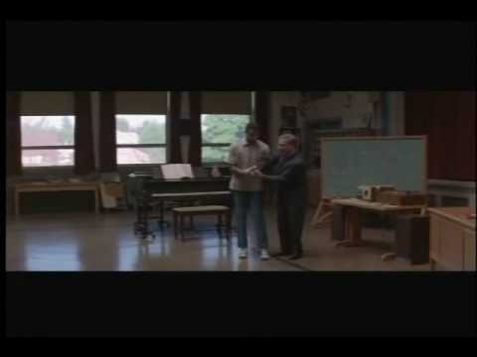

Slide 12
Academically prepared for postsecondary success
= Process (Lead Measure)
High School Graduation
Postsecondary
Success
= Results (Lag Measure)
Notes:
Add “Board” outcomes -
Connect the dots!!!

Slide 14
Accreditation & Design Team Mission
Within a system of accreditation and design, provide accountability along with support to move systems toward ensuring the success of each student.

Slide 17
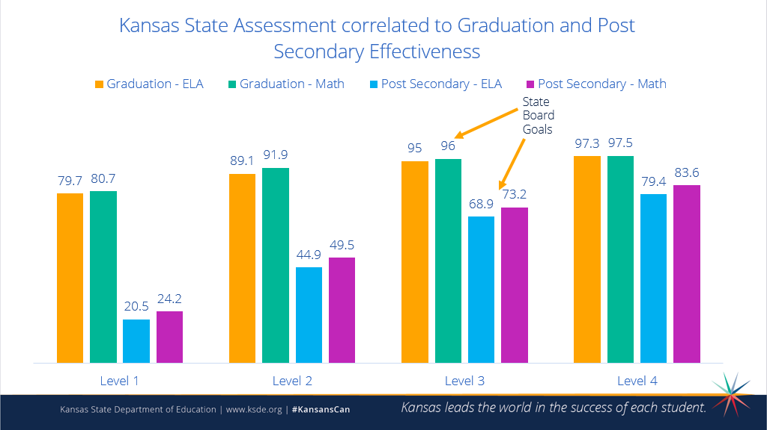
Notes:
This is based on the 10th grade assessment from 2019 with graduation rate as 2019 and post-secondary being pulled in 2021.

Slide 18
KESA & Definition of Accreditation
Notes:
Sarah

Slide 19
Accreditation Definitions
“Accredited” - In Compliance / Evidence of Process AND Growth (Results)
“Conditionally Accredited” - In Compliance / Insufficient Evidence of either Process OR Growth (Results)
“Not Accredited” - Not in Compliance OR Insufficient Evidence of Process AND Growth (Results)
Notes:
In Kansas, in order to be considered for state accreditation you have to be in compliance with the State Board of Education, and you have to be utilizing the foundational structures. Once you have met those two requirements, you can then work through your accreditation cycle. Upon completion of the accreditation cycle, you submit your work to the Accreditation Review Council, and they make a recommendation to the State Board of Education regarding your accreditation status. The Board then votes to approve/disapprove your recommendation.
You can be ‘accredited’, which means…
You can be ‘conditionally accredited’, which means you are accredited, but you have some areas you are needing to work on. Conditionally means…
Or, your can be ‘not accredited’, which means…

Slide 20
Focus Areas for Accreditation
Growth in Student Performance (Results)
Process
Compliance
Notes:
Accreditation really is about three things: Results/Growth in student performance; Quality, intentional growth process; and compliance.
In order to support you demonstrating those three things, we have some resources available to you.
*Go through each resource*
Results = Accountability Report
Process = System Information Page
Compliance = Contact Sheet

Slide 21
Focus Group Feedback

Slide 22
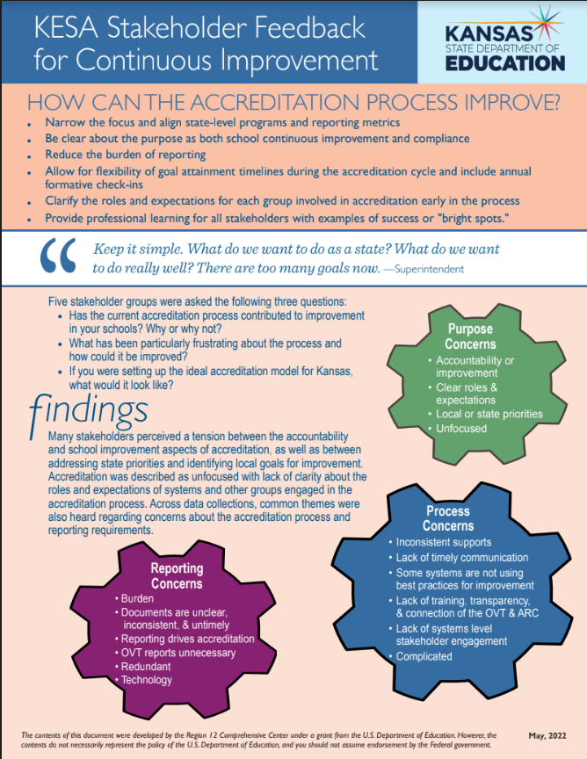
Focus Group Feedback
Superintendents
Curriculum Leaders
Accreditation Advisory Council
KESA Regional Training Pilot Systems
2023-
2024
2023-
2024
NOW
Notes:
STAMP (using ‘Annotate’) using the heart, star, or checkmark what resonates most for you on this feedback form.

Slide 23
Survey Legislation:
Impact on Accreditation
Continue the focus on social-emotional learning
Use of universal screeners and climate surveys
Alternatives to surveys for measuring SEG:
•The Social-Emotional Growth Rubric
•Use existing measures such as:
•Attendance
•Discipline
•Grades
•Standards based grading using social emotional, character development standards
Continue to use surveys, be open and transparent, and report aggregate data from students who opt-in
Notes:
In 2015, Commissioner Dr. Randy Watson and Deputy Commissioner Dr. Brad Neuenswander toured the state asking Kansans what they thought a successful Kansas graduate should know and be able to do. Surprisingly, many of the responses had to do with non-academic skills, what we now call ‘Student Success Skills’, like persistence, time management, self-regulation. While content knowledge and critical thinking were stated as priorities, they were not any more important than the success skills students possessed upon graduation.
In 2021, Dr. Watson and Dr. Neuenswander set out on an even larger tour of the state to determine if Kansans still valued the same things. And what did they learn? Kansans still want to see students graduate who have both the academic skills and the success skills that are required in the workplace. Thus, the Kansas State Board of Education still maintains that Student’s Social Emotional Learning is a top outcome to be measured locally.
Many systems choose to utilize social-emotional screeners, such as, SAEBERS, SRSS-IE, etc. These can be valuable tools in assessing the individual needs of students and aligning the appropriate tiered intervention to support social-emotional development. These tools are not intended to measure systemic growth of social-emotional competencies, but rather they should inform how systems intervene. Other surveys are often used to assess school/system climate, such as, Panorama, ACT Mosaic, and Kansas Communities that Care. These too are valuable tools, but they may contain questions that some parents would find intrusive. It is always best practice to be transparent with parents and community about the surveys, their purpose, and to provide an opportunity to opt-on.
How might you measure SEL without the use of student surveys? Consider what impact you want your SEL work to have on students? Are you working with them on time-management and organization to help them reduce the number of incomplete assignments and improve their grades? Great! Track that and use it as a local measure. Are you hoping to decrease office referrals and suspensions by teaching conflict management, resilience, and self-regulation? Great! Track that and use it as a local measure! Are you wanting students to grow their success skills? Use the Social Emotional Character Development Standards and use ‘Standards Based Grading’ to track how many students are demonstrating proficiency/mastery of the SECD standards.
While you can still administer surveys following the opt-in procedures and report that data, there are others way in which you can track the impact of your SEL work that do not depend on student-completed surveys. The goal in accreditation is to demonstrate growth in student performance. So long as your measures are still tied to student achievement/outcomes, then you can be flexible on selecting the measure for your work . The measure should: match the outcome, align with existing data, and follow the regulation regarding student-completed surveys.

Slide 24
Breakout Rooms
Notes:
Year 1 - Needs Assessment & Goals (Jay)
Years 2-4 - Continuous School Improvement; working with your OVT (Sarah) (Doug) 2nd time
Year 5 - Walk through Summer Check In template & timeline for the year; working with your OVT (Myron) (Doug) 1st time
Frame out questions for each group and anticipate their questions
Question for groups:
In what ways do your system goals “connect” to the State boards vision, goals, outcomes? After connecting the dots, allow them to talk about how their vision,goals, outcomes align?
Follow up, how are these connecting to the building and to the classroom?

Slide 26
Year 1 Agenda
Phase 1 - Data Analysis & Phase 2 - Setting Goals
Reporting Expectations for Year 1
Discussion Questions:
What did you learn from the first cycle?
What’s important right now
What are your current challenges?
What do you want to accomplish by this time next year?
Q & A

Slide 27
Years 2-4
Continuous improvement process
Compliance
Needs assessment and goals
Reporting expectations years 2 - 4
Strategies and strategy implementation (not reported in 22-23)
Assurances (reported annually)
Making the most of your OVT process
Q & A

Slide 28
Year 5 - Agenda
Timeline: System Report → State Board Vote
Reporting Expectations
System & OVT
Accountability Report & Local Data
OVT Visit Date (accreditation@ksde.org)
Summer Check In Questions
ARC Criteria
Q&A
Notes:
Timeline: System Report → State Board Vote
The process of writing your system report and receiving your final accreditation status from the state board is a multi-month process. Between each step in the process there is a 30 day window. Review the timeline on the next page for a fuller picture.
Reporting Expectations
System & OVT
NO CHANGE! Be clear and concise. Make sure your work is well-documented, well-defined, and that you balance narrative with evidence/data. Weave in the data that is most important and refer to artifacts if/when necessary.
Accountability Report & Local Data
What should you include?
OVT Visit Date (accreditation@ksde.org)
Summer Check In Questions
Email us your visit date. The role of the OVT is to provide feedback and direction. You are to challenge and offer questions for ongoing exploration.
ARC Criteria
Q&A

Slide 29
Timeline
System writes their year 5 report, uploads to app & shares with OVT October 12
30 Days
OVT Visit November 12
30 Days
OVT Report Submitted in the Authenticated App. December 12
30 Days
Materials to ARC & Vote January 12
30 Days
Board - Receive February 12
30 Days
Board Action March 12

Slide 30
CBA - Component Baseline Analysis

Slide 31
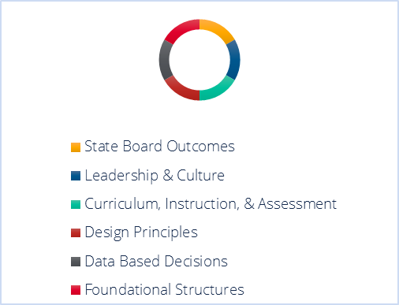
Component Baseline Analysis
What is it?
Perception Survey
Who takes it?
All Certified Staff/Administrators
How do you administer the survey?
Via a Qualtrics Link (Preview Items)
How do I get my data?
Email accreditation@ksde.org
How can I learn more?
Tuesday, August 30 from 9:00-9:30 am (zoom link; 791056)
Thursday, September 1 from 1:00-1:30 pm (zoom link; 791056)

Slide 32
Closing & Next Steps

Slide 33
What’s next?
KESA Webpage
Training & Calendar
Communication & Connecting with ADT
Authenticated Application Technical Assistance
Sign On/Login = helpdesk@ksde.org
Content = accreditation@ksde.org
All other questions
accreditation@ksde.org
Notes:
Sarah

Slide 34
Accreditation and Design Team (785) 296-8012 accreditation@ksde.org

Slide 35
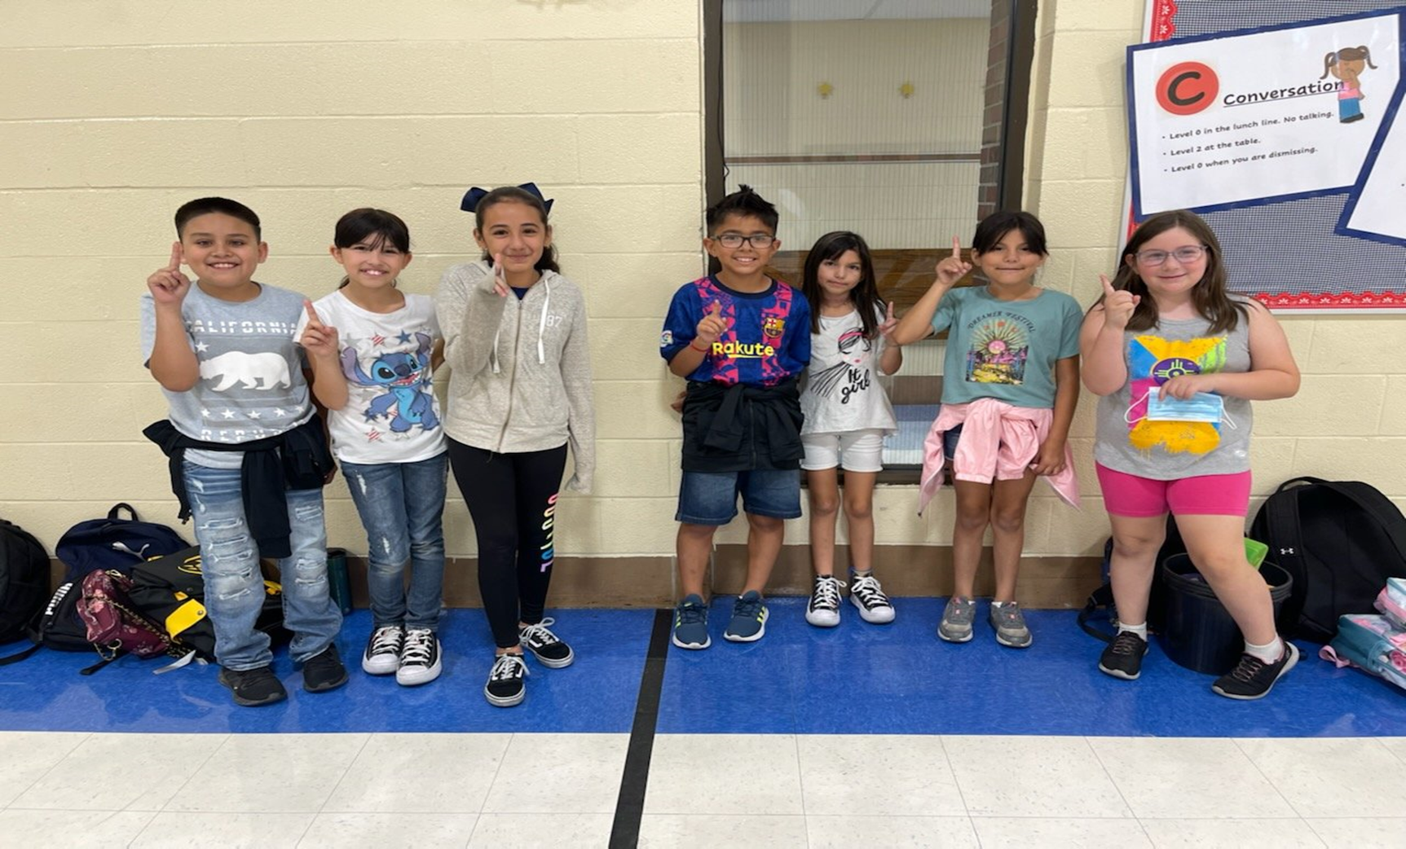
Wishing you a great year ahead!

